Slide 1
Java Capability
Spring

Slide 2
Agenda
Agenda 1
Agenda 2

Slide 3
Prerequisites
Before proceeding with this tutorial, you should have a good understanding of Java programming language. A basic understanding of Eclipse IDE is also required because all the examples have been compiled using Eclipse IDE.

Slide 4
What is Spring
Spring framework is said to be a non-invasive means it doesn’t force a programmer to extend or implement their class from any predefined class or interface given by Spring API, in struts we used to extend Action Class right that’s why struts is said to be invasive
Spring is a lightweight framework. It can be thought of as a framework of frameworks because it provides support to various frameworks such as Struts, Hibernate, Tapestry, EJB, JSF etc. The framework, in broader sense, can be defined as a structure where we find solution of the various technical problems.
The Spring framework comprises several modules such as IOC, AOP, DAO, Context, ORM, WEB MVC etc.

Slide 5
Spring having this much of demand because of the following 3 reasons….
Simplicity
Testability
Loose Coupling
Simplicity
Spring framework is simple because as it is non-invasive, POJO and POJI model

Slide 6
TESTABILITY
Actually for writing the spring application, server [Container] is not mandatory, but for struts applications we need a server, and for EJB too. If we want to test the application it may need lot of changes in the source and each time we must restart the server to view the changes, which is little tedious and time taking but we can over come this in Spring, for testing spring application server is not mandatory spring has it own container to run the applications.
Spring can be used to develop any kind of java application, means we can develop starting from console application to enterprise level application

Slide 7
Loose Coupling
DI(Dependency Injection):
Dependency injection is a pattern used to create instances of objects that other objects rely upon without knowing at compile time which class will be used to provide that functionality or simply the way of injecting properties to an object is called dependency injection.
We have two types of Dependency injection
--Constructor Injection
--Setter/Getter Injection
Spring will support only Constructor Injection and Setter/Getter Injection.

Slide 8
Loose Coupling
IOC(Inversion Of Control):
Giving control to the container to create and inject instances of objects that your application depend upon, means instead of you are creating an object using the new operator, let the container do that for you. Inversion of control relies on dependency injection because a mechanism is needed in order to activate the components providing the specific functionality
The two concepts work together in this way to allow for much more flexible, reusable, and encapsulated code to be written. As such, they are important concepts in designing object-oriented solutions.

Slide 9
Loose Coupling EXAMPLE
Eclipse: Java project
Add: spcore.jar to build path(lib folder)
public class Student {
private String name;
private int age;
//Generate Getter/Setter methods
public void displayInfo(){
System.out.println("Hello: "+name +);
System.out.println(“Your Age : “ + age +);
}
}

Slide 10
Loose Coupling EXAMPLE
XML (filename: Beans.xml place it inside src folder)
<beans xmlns = "http://www.springframework.org/schema/beans" xmlns:xsi = "http://www.w3.org/2001/XMLSchema-instance"
xsi:schemaLocation = "http://www.springframework.org/schema/beans http://www.springframework.org/schema/beans/spring-beans-3.0.xsd">
<bean id="studentbean" class="com.hcl.Student">
<property name="name" value=“HCL"></property>
<property name=“age" value=“45"></property>
</bean> </beans>
Main Method
public class MainApp {
public static void main(String[] args) {
Resource context = new ClassPathResource("Beans.xml");
BeanFactory factory = new XmlBeanFactory(context);
Student student=(Student)factory.getBean("studentbean");
student.displayInfo();
}
}

Slide 11
Spring Features
Use Spring Framework for writing web applications(Spring MVC)
Use Spring Framework for exposing RESTful services(JERSEY,SOAP,REST)
Use Spring Framework to secure your web applications.(Spring Security)
Use Spring Framework for communicating with databases(JDBC, ORM,Spring Data)
Use Spring Framework for handling long running jobs.(Spring Batch)
Use Spring Framework to handle external resources or systems you have to work with(Spring Integration)
Use Spring Framework to convert your application into an executable.(Spring Boot)

Slide 12
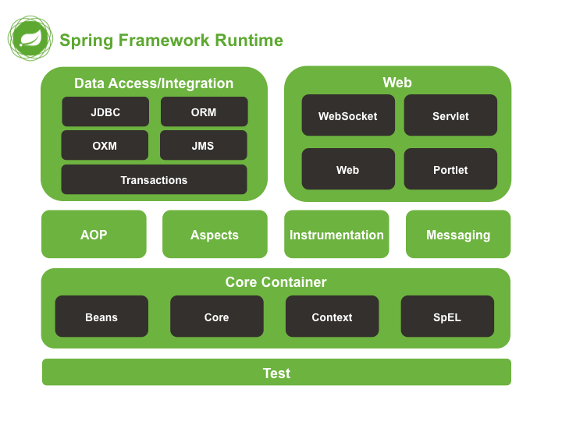
Spring Architecture

Slide 13
Core Container
The Core Container consists of the Core, Beans, Context, and Expression Language modules the details of which are as follows −
The Core module provides the fundamental parts of the framework, including the IoC and Dependency Injection features.
The Bean module provides BeanFactory, which is a sophisticated implementation of the factory pattern.
The Context module This module supports internationalization (I18N), EJB, JMS, Basic Remoting..
The SpEL module provides a powerful expression language for querying and manipulating an object graph at runtime.

Slide 14
Data Access/Integration
The Data Access/Integration layer consists of the JDBC, ORM, OXM, JMS and Transaction modules whose detail is as follows −
The JDBC module provides a JDBC-abstraction layer that removes the need for tedious JDBC related coding.
The ORM module provides integration layers for popular object-relational mapping APIs, including JPA, JDO, Hibernate, and iBatis.
The OXM module provides an abstraction layer that supports Object/XML mapping implementations for JAXB, Castor, XMLBeans, JiBX and XStream.
The Java Messaging Service JMS module contains features for producing and consuming messages.
The Transaction module supports programmatic and declarative transaction management for classes that implement special interfaces and for all your POJOs.

Slide 15
Web
The Web layer consists of the Web, Web-MVC, Web-Socket, and Web-Portlet modules the details of which are as follows −
The Web module provides basic web-oriented integration features such as multipart file-upload functionality and the initialization of the IoC container using servlet listeners and a web-oriented application context.
The Web-MVC module contains Spring's Model-View-Controller (MVC) implementation for web applications.
The Web-Socket module provides support for WebSocket-based, two-way communication between the client and the server in web applications.
The Web-Portlet module provides the MVC implementation to be used in a portlet environment and mirrors the functionality of Web-Servlet module.

Slide 16
IOC CONTAINER
The IoC container is responsible to instantiate, configure and assemble the objects. The IoC container gets informations from the XML file and works accordingly. The main tasks performed by IoC container are:
to instantiate the application class
to configure the object
to assemble the dependencies between the objects
There are two types of IoC containers. They are:
BeanFactory
ApplicationContext

Slide 17
Difference between BeanFactory and the ApplicationContext
The org.springframework.beans.factory.BeanFactory (lazy loading) and the org.springframework.context.ApplicationContext (Eager loading) interfaces acts as the IoC container. The ApplicationContext interface is built on top of the BeanFactory interface.
It adds some extra functionality than BeanFactory such as simple integration with Spring's AOP, message resource handling (for I18N), event propagation, application layer specific context (e.g. WebApplicationContext) for web application. So it is better to use ApplicationContext than BeanFactory.

Slide 18
BeanFactory
The XmlBeanFactory is the implementation class for the BeanFactory interface. To use the BeanFactory, we need to create the instance of XmlBeanFactory class as given below:
Resource resource=new ClassPathResource("applicationContext.xml");
BeanFactory factory=new XmlBeanFactory(resource);

Slide 19
ApplicationContext
The ClassPathXmlApplicationContext class is the implementation class of ApplicationContext interface. We need to instantiate the ClassPathXmlApplicationContext class to use the ApplicationContext as given below:
ApplicationContext context = new ClassPathXmlApplicationContext("applicationContext.xml");

Slide 20
DEPENDENCY INJECTION
Java Dependency Injection design pattern allows us to remove the hard-coded dependencies and make our application loosely coupled, extendable and maintainable.
Types of dependency injections
For injecting the required things to the current spring class (spring bean) , spring ioc container will do this in different ways…
Setter injection
Construction injection

Slide 21
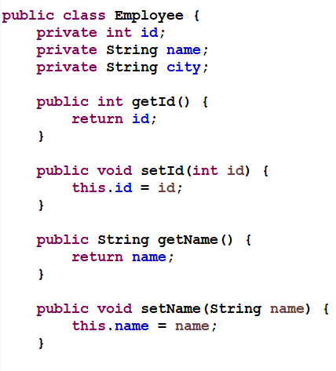
DEPENDENCY INJECTION USING SETTER INJECTION

Slide 22
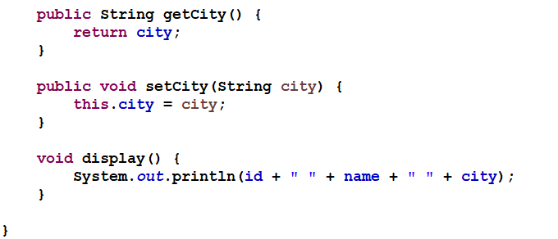
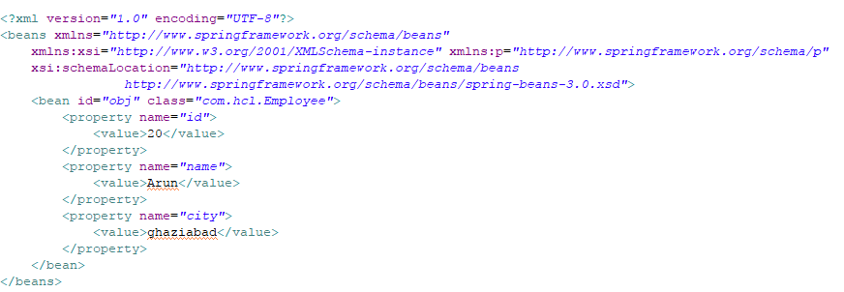
DEPENDENCY INJECTION USING SETTER INJECTION

Slide 23
DEPENDENCY INJECTION USING SETTER INJECTION
public class SetterInjectionExample {
public static void main(String[] args) {
Resource resource=new ClassPathResource("applicationContext.xml");
BeanFactory factory=new XmlBeanFactory(resource);
Employee employee=(Employee)factory.getBean("obj");
employee.display();
}
}

Slide 24
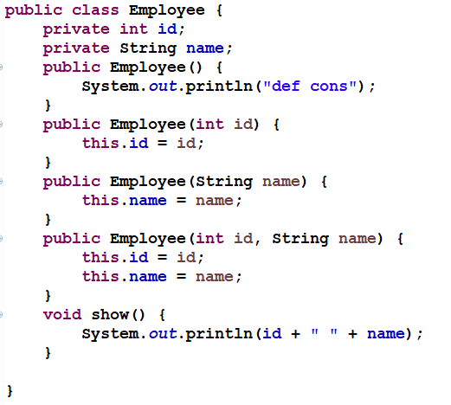
Dependency injection with constructor injection

Slide 25
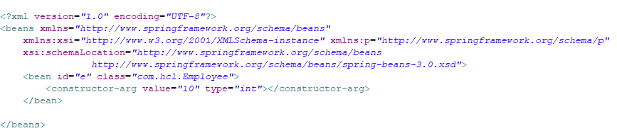
Dependency injection with constructor injection

Slide 26
Dependency injection with constructor injection
import org.springframework.beans.factory.BeanFactory;
import org.springframework.beans.factory.xml.XmlBeanFactory;
import org.springframework.core.io.*;
public class ConstructorInjection {
public static void main(String[] args) {
ApplicationContext context = new ClassPathXmlApplicationContext("applicationContext.xml");
Employee employee=(Employee)context.getBean(“obj");
employee.display();
}
}

Slide 27
autowire
Spring @Autowired annotation is used for automatic dependency injection. Spring framework is built on dependency injection and we inject the class dependencies through spring bean configuration file.
Usually we provide bean configuration details in the spring bean configuration file and we also specify the beans that will be injected in other beans using ref attribute. But Spring framework provides autowiring features too where we don’t need to provide bean injection details explicitly.

Slide 28
autowire
autowire byName – For this type of autowiring, setter method is used for dependency injection. Also the variable name should be same in the class where we will inject the dependency and in the spring bean configuration file.
autowire byType – For this type of autowiring, class type is used. So there should be only one bean configured for this type in the spring bean configuration file.
autowire by constructor – This is almost similar to autowire byType, the only difference is that constructor is used to inject the dependency.
autowire by autodetect – If you are on Spring 3.0 or older versions, this is one of the autowire options available. This option was used for autowire by constructor or byType, as determined by Spring container.

Slide 29
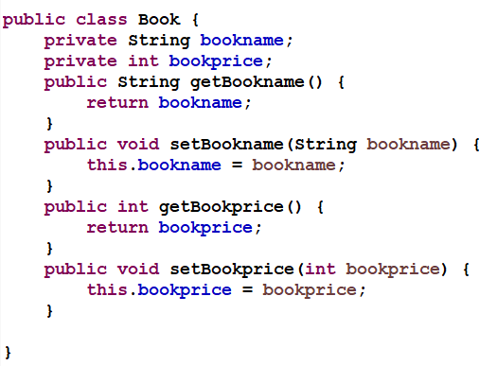
Spring Autowiring byName

Slide 30
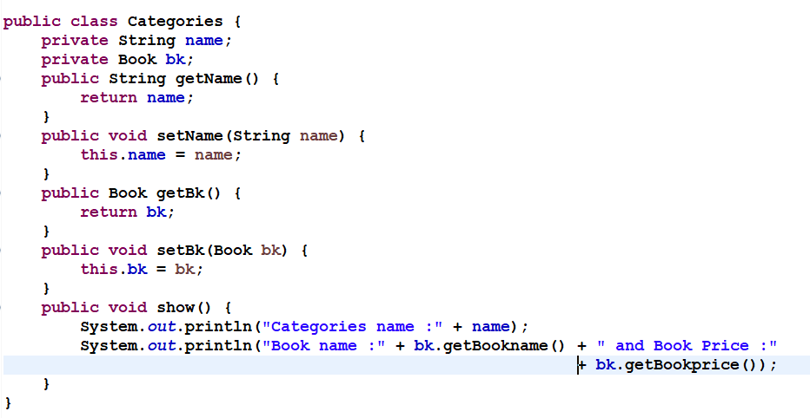
Spring Autowiring byName

Slide 31
Spring Autowiring byName
import org.springframework.beans.factory.BeanFactory;
import org.springframework.beans.factory.xml.XmlBeanFactory;
import org.springframework.core.io.ClassPathResource;
import org.springframework.core.io.Resource;
public class ClientLogic {
public static void main(String[] args) {
Resource res = new ClassPathResource("spconfig.xml");
BeanFactory factory = new XmlBeanFactory(res);
Object object = factory.getBean("id1");
Categories category = (Categories) object;
category.show();
}
}

Slide 32
Spring Autowiring byName
<!DOCTYPE beans PUBLIC "-//SPRING//DTD BEAN 2.0//EN"
"http://www.springframework.org/dtd/spring-beans-2.0.dtd">
<beans>
<bean id="id1" class=“com.hcl.Categories" autowire="byName">
<property name="name" value="General Books" />
</bean>
<bean id="bk" class=“com.hcl.Book">
<property name="bookname" value="The Kids" />
<property name="bookprice" value="300" />
</bean>
</beans>

Slide 33
Spring Autowiring byType
public class Book {
private String bookName;
private int bookPrice;
public String getBookName() {
return bookName;
}
public void setBookName(String bookName) {
this. bookName = bookName;
}
public int getBookprice() {
return bookprice;
}
public void setBookprice(int bookprice) {
this.bookprice = bookprice;
}
}

Slide 34
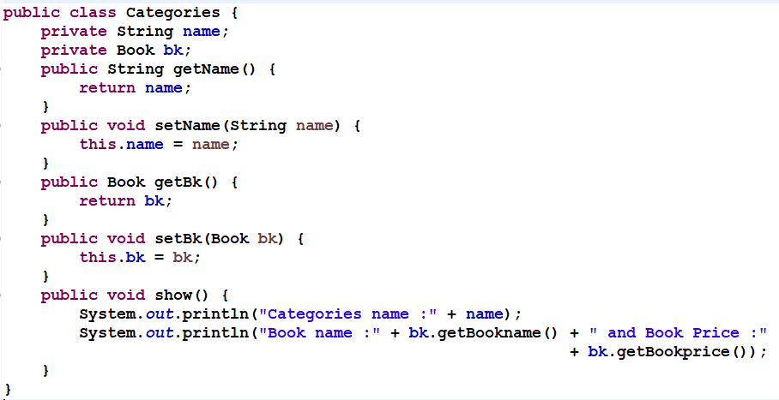
Spring Autowiring byType

Slide 35
Spring Autowiring byType
import org.springframework.beans.factory.BeanFactory;
import org.springframework.beans.factory.xml.XmlBeanFactory;
import org.springframework.core.io.ClassPathResource;
import org.springframework.core.io.Resource;
public class ClientLogic {
public static void main(String[] args) {
Resource res = new ClassPathResource("spconfig.xml");
BeanFactory factory = new XmlBeanFactory(res);
Object object = factory.getBean("id1");
Categories categories = (Categories) object;
categories.show();
}
}

Slide 36
Spring Autowiring byType
<beans xmlns = "http://www.springframework.org/schema/beans" xmlns:xsi = "http://www.w3.org/2001/XMLSchema-instance"
xsi:schemaLocation = "http://www.springframework.org/schema/beans http://www.springframework.org/schema/beans/spring-beans-3.0.xsd">
<bean id="id1" class=“com.hcl.Categories" autowire="byType">
<property name="name" value="General Books" />
</bean>
<bean id="SomeThing" class=“com.hcl.Book">
<property name="bookname" value="The Kids" />
<property name="bookprice" value="300" />
</bean>
</beans>

Slide 37
Spring MVC

Slide 38
Introduction to MVC
The Model encapsulates the application data and in general they will consist of POJO.
The View is responsible for rendering the model data and in general it generates HTML output that the client's browser can interpret.
The Controller is responsible for processing user requests and building an appropriate model and passes it to the view for rendering

Slide 39
Introduction to Spring MVC
Spring MVC tutorial provides an elegant solution to use MVC in spring framework by the help of DispatcherServlet.
In Spring Web MVC, DispatcherServlet class works as the front controller. It is responsible to manage the flow of the spring mvc application.
The @Controller annotation is used to mark the class as the controller in Spring 3.
The @RequestMapping annotation is used to map the request url. It is applied on the method.

Slide 40
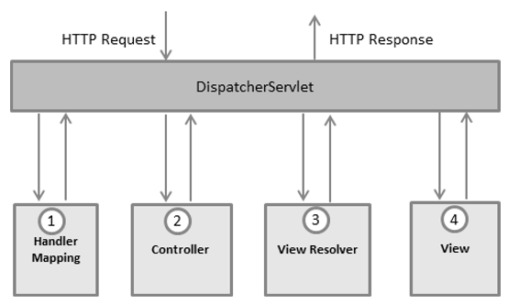
DispatcherServlet
The Spring Web model-view-controller (MVC) framework is designed around a DispatcherServlet that handles all the HTTP requests and responses. The request processing workflow of the Spring Web MVC DispatcherServlet is illustrated in the following diagram −

Slide 41
DispatcherServlet
After receiving an HTTP request, DispatcherServlet consults the HandlerMapping to call the appropriate Controller.
The Controller takes the request and calls the appropriate service methods based on used GET or POST method. The service method will set model data based on defined business logic and returns view name to the DispatcherServlet.
The DispatcherServlet will take help from ViewResolver to pickup the defined view for the request.
Once view is finalized, The DispatcherServlet passes the model data to the view which is finally rendered on the browser.

Slide 42
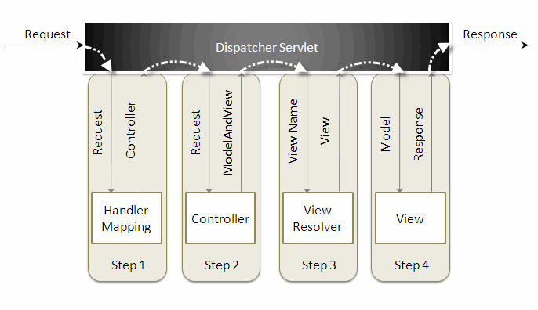
Understanding the flow of Spring Web MVC

Slide 43
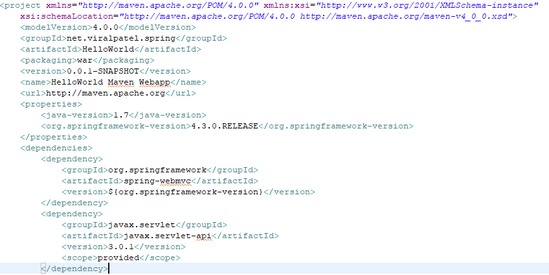
POM.XML

Slide 44
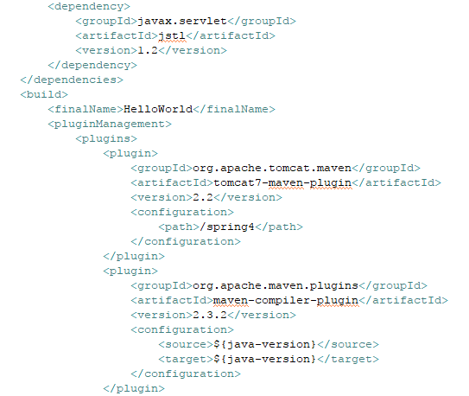
POM.XML

Slide 45
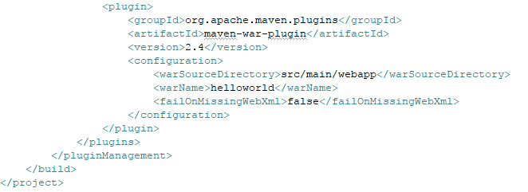
POM.XML

Slide 46
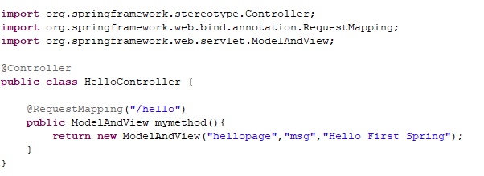
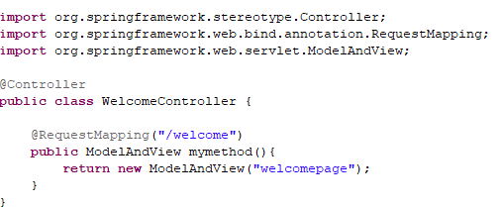
Controller

Slide 47
Define the bean in the xml file
This is the important configuration file where we need to specify the ViewResolver and View components.
The context:component-scan element defines the base-package where DispatcherServlet will search the controller class.
Here, the InternalResourceViewResolver class is used for the ViewResolver.
The prefix+string returned by controller+suffix page will be invoked for the view component.
This xml file should be located inside the WEB-INF directory.

Slide 48
spring-servlet.xml
<beans>
<context:component-scan base-package="com.hcl" />
<bean class="org.springframework.web.servlet.view.InternalResourceView Resolver">
<property name="prefix" value="/WEB-INF/jsp/" />
<property name="suffix" value=".jsp" />
</bean>
</beans>

Slide 49
Display the message in the JSP page
This is the simple JSP page, displaying the message returned by the Controller.
It must be located inside the WEB-INF/jsp directory for this example only.
--hellopage.jsp
Message is: ${msg}

Slide 50
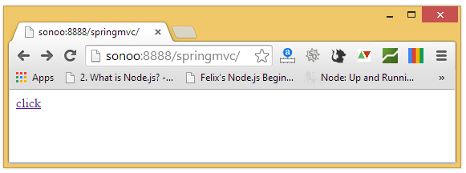
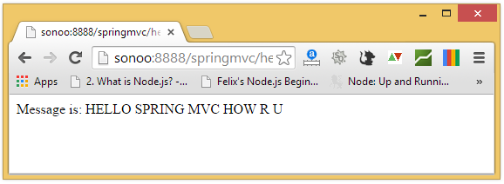
Output

Slide 51
Spring MVC with annotation
XML Tag | Annotation | Description
<context:component-scan/> | @ComponentScan() | Scan starts from base package and registers all controllers, repositories, service, beans, etc.
<mvc:annotation-driven/> | @EnableWebMvc | Enable Spring MVC-specific annotations like @Controller
Spring config file | @Configuration | Treat as the configuration file for Spring MVC-enabled applications.

Slide 52
Spring MVC with annotation example
index.jsp
<a href="index">click</a>
@Controller
public class HelloController {
@RequestMapping("index")
public ModelAndView sayHello() {
ModelAndView model = new ModelAndView("hello");
model.addObject("msg", "say hello from controller");
return model;
}
}

Slide 53
Spring MVC with annotation example
@Configuration
@EnableWebMvc
@ComponentScan(basePackages="com.hcl.spring.controller")
public class SpringConfiguration {
@Bean(name="jspViewResolver")
public ViewResolver viewResolver()
{
InternalResourceViewResolver viewResolver=new InternalResourceViewResolver();
viewResolver.setPrefix("WEB-INF/views/");
viewResolver.setSuffix(".jsp");
return viewResolver;
}
}

Slide 54
Hello.jsp
${msg}

Slide 55
Annotations in Spring 3 MVC:
@Controller
@RequestMapping (URL/URI → Browser, Form action=, href=)
@PathVariable
@RequestPARAM
@Autowired
@ModelAttribute
@Value
@Qualifier
@Component
@Service
@Repository
@Controller

Slide 56
@Controller:
This annotation is used at the class level.
Denotes that the marked class acts as a controller.
Eg:
import org.springframework.stereotype.Controller;
@Controller
public class StudentController {
}

Slide 57
@RequestMapping
This annotation can be used at the class level and method level.
This annotation accepts the following as its parameters.Please note that all the arguments are optional.
String[ ] values – Represents an array of URLs which tells that the controller should be invoked for the request which arrive with the list of URLs mentioned. Eg: @RequestMapping(value={"/welcome", "/test"}.
String[] Params – An array of Request Parameters and their values which can be used to validate if a particular request parameter has a value. Eg. @RequestMapping(params="myParam=myValue")

Slide 58
@RequestMapping
RequestMethod[ ] methods – An array of HTTP methods. This is optional parameter and when not mentioned, the default method is HTTP GET. If specifically mentioned like POST, TRACE etc., then the method or controller will be invoked only when the request comes with the mentioned method. Eg: @RequestMapping(method=RequestMethod.GET).
String[] headers – An array of headers which can be used to validate the values that the headers carry in request object. This is used for validation purposes same as the Params[] discussed earlier. Eg.@RequestMapping(headers = "content-type=text/*")

Slide 59
@Controller
@Controller
public class HelloWorldController
{
@RequestMapping(“/hi”, method = RequestMethod.GET)
public String hello()
{
return "hello";
}
}

Slide 60
@RequestParam &@PathVariable
Both annotations @RequestParam and @PathVariable in Spring MVC are used for fetching the values of request parameters.
These annotations have similar purpose but some differences in use.
The key difference between @RequestParam and @PathVariable is that @RequestParam used for accessing the values of the query parameters where as @PathVariable used for accessing the values from the URI template.
http://localhost:8080/tutorials/bookmark/100?site=dineshonjava site is @RequestParam 100 is @PathVariable

Slide 61
@AutoWired
If autowiring is enabled then spring container will take care about injecting the dependencies, programmer no need to configure into an xml file explicitly.
Autowiring is only supported if the dependencies are in the form of objects only, to enable autowiring, we should add autowire attribute to the bean element.
@Service
public class CompanyServiceImpl implements CompanyService {
@Autowired
private CompanyDAO companyDAO;
}

Slide 62
@ModelAttribute
An @ModelAttribute on a method argument indicates the argument should be retrieved from the model. If not present in the model, the argument should be instantiated first and then added to the model.
Once present in the model, the argument's fields should be populated from all request parameters that have matching names. This is known as data binding in Spring MVC, a very useful mechanism that saves you from having to parse each form field individually.
@RequestMapping("/add")
public String saveNewCompany(@ModelAttribute Company company) {
companyService.add(company);
return "redirect:" + company.getName();
}

Slide 63
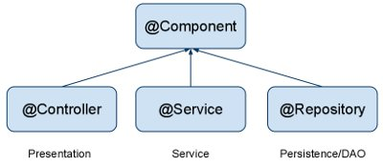
@Component
Annotate your other components (for example REST resource classes) with @Component.
@Component
public class ContactResource {
...
}

Slide 64
@Component
@Service
Annotate all your service classes with @Service. All your business logic should be in Service classes.
@Service
public class CompanyServiceImpl implements CompanyService {
}
@Repository
Annotate all your DAO classes with @Repository. All your database access logic should be in DAO classes.
@Repository
public class CompanyDAOImpl implements CompanyDAO {
}

Slide 65
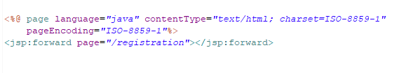
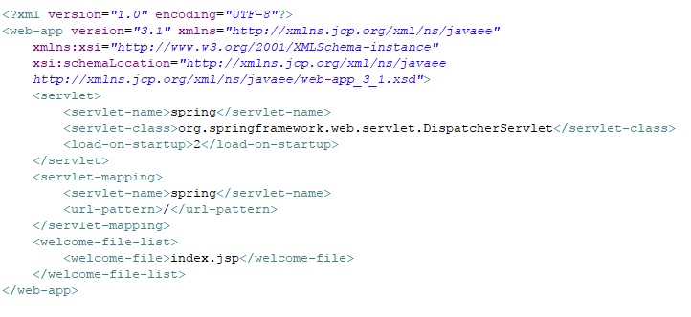
SPRING FORM HANDLING EXAMPLE

Slide 66
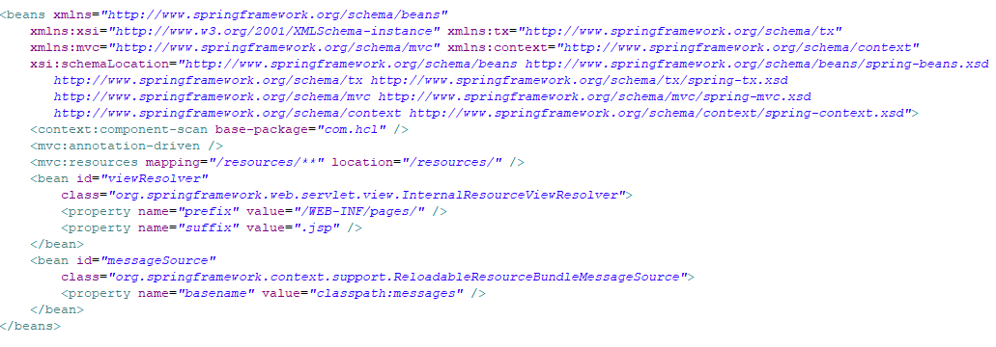
SPRING FORM HANDLING EXAMPLE

Slide 67
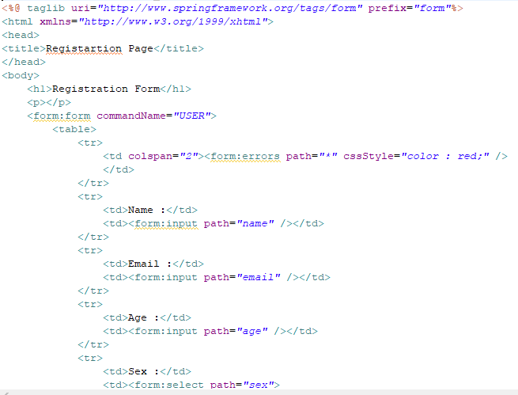
SPRING FORM HANDLING EXAMPLE

Slide 68
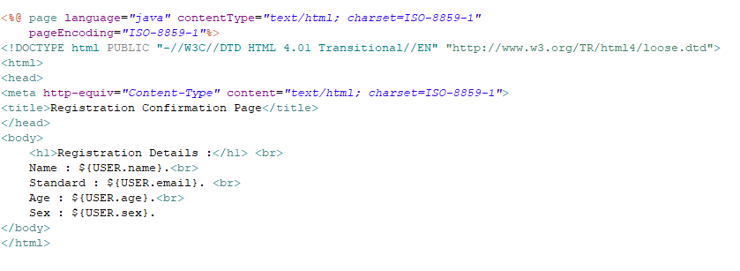
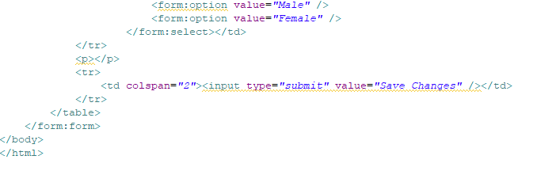
SPRING FORM HANDLING EXAMPLE

Slide 69
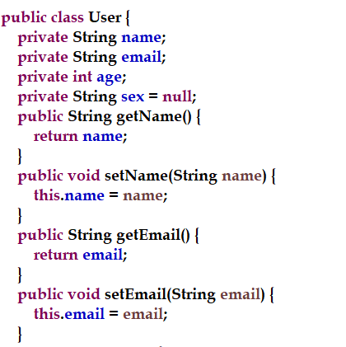
SPRING FORM HANDLING EXAMPLE

Slide 70
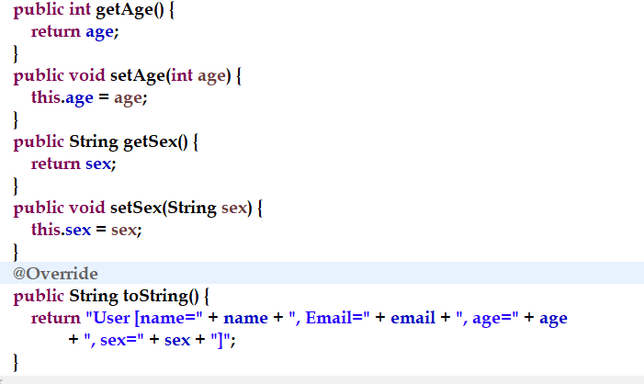
SPRING FORM HANDLING EXAMPLE

Slide 71
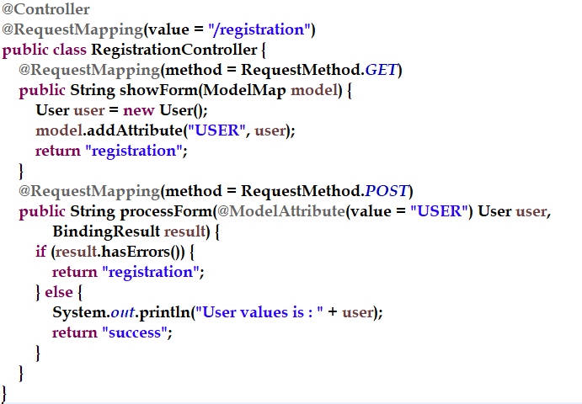
SPRING FORM HANDLING EXAMPLE

Slide 72
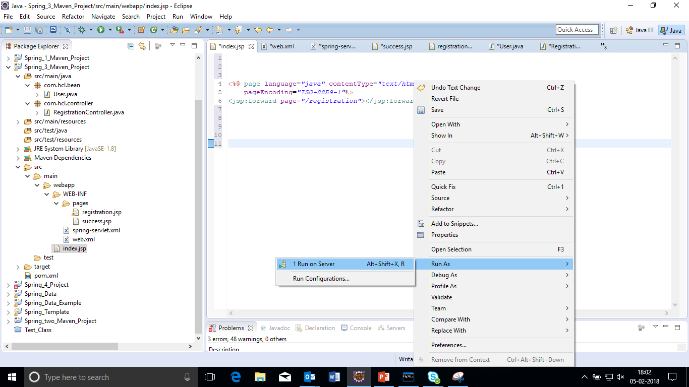
SPRING FORM HANDLING EXAMPLE

Slide 73
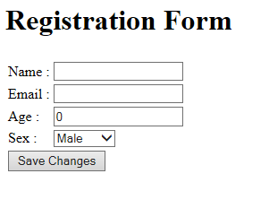
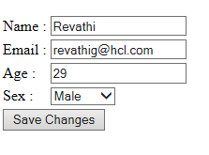
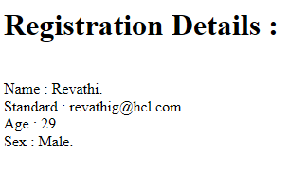
SPRING FORM HANDLING EXAMPLE

Slide 74
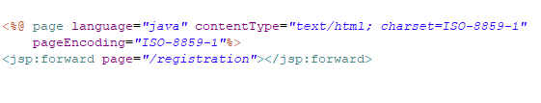
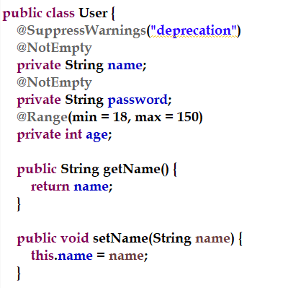
SPRING FORM HANDLING WITH VALIDATION EXAMPLE

Slide 75
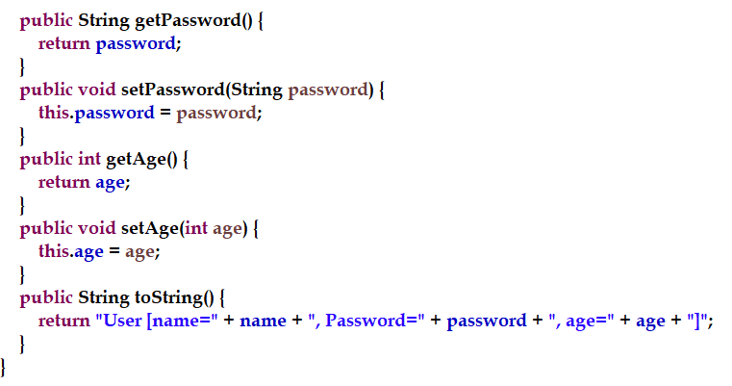
SPRING FORM HANDLING WITH VALIDATION EXAMPLE

Slide 76
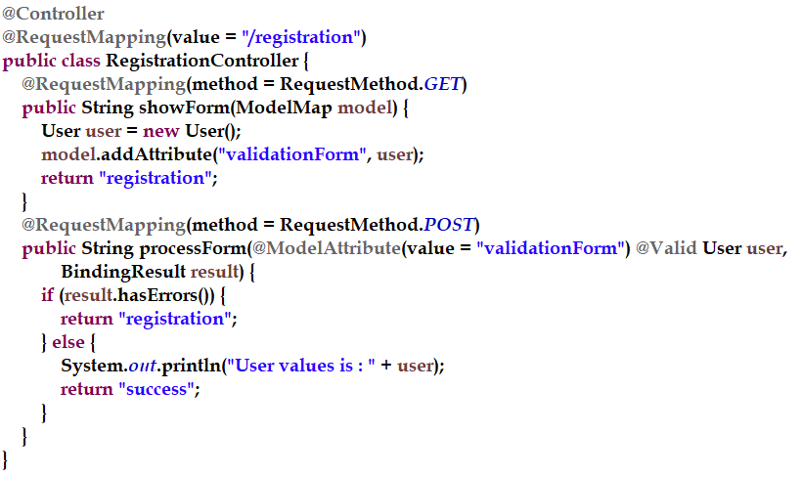
SPRING FORM HANDLING WITH VALIDATION EXAMPLE

Slide 77
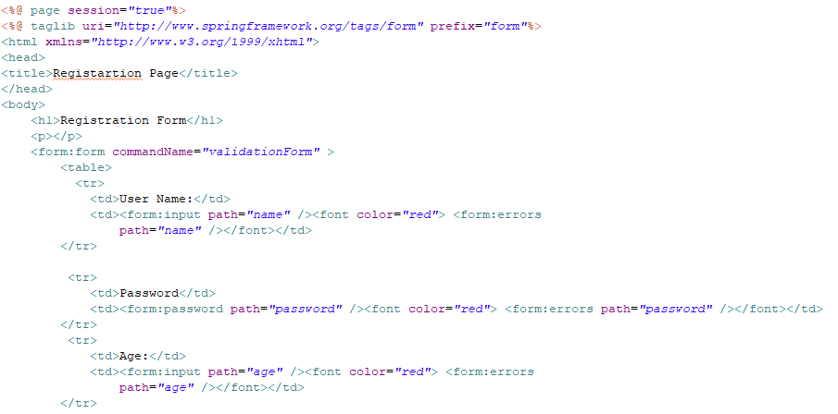
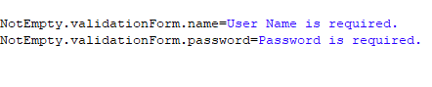
SPRING FORM HANDLING WITH VALIDATION EXAMPLE

Slide 78
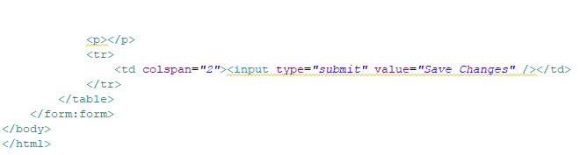
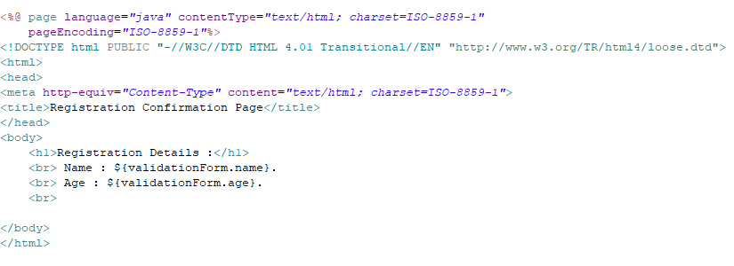
SPRING FORM HANDLING WITH VALIDATION EXAMPLE

Slide 79
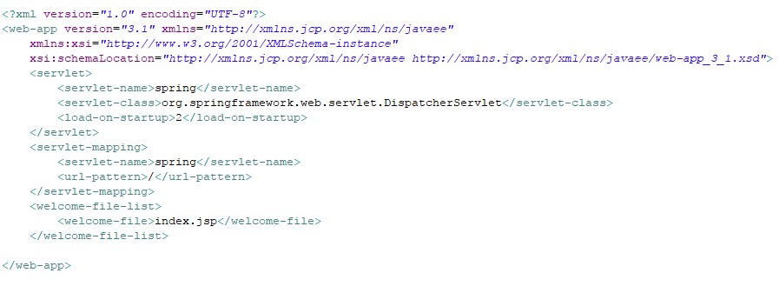
SPRING FORM HANDLING WITH VALIDATION EXAMPLE

Slide 80
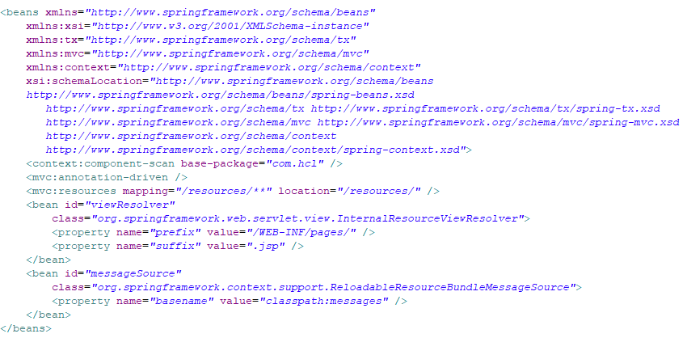
SPRING FORM HANDLING WITH VALIDATION EXAMPLE

Slide 81
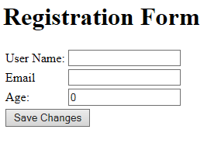
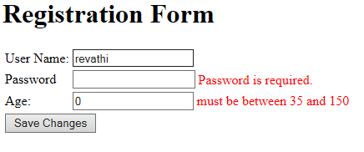
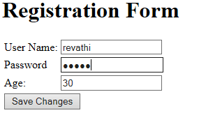
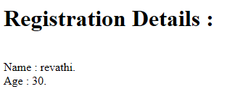
SPRING FORM HANDLING WITH VALIDATION EXAMPLE

Slide 82
SPRING WITH DATABASe
Spring JdbcTemplate is a powerful mechanism to connect to the database and execute SQL queries. It internally uses JDBC api, but eliminates a lot of problems of JDBC API.
Problems of JDBC API
The problems of JDBC API are as follows:
We need to write a lot of code before and after executing the query, such as creating connection, statement, closing resultset, connection etc.
We need to perform exception handling code on the database logic.
We need to handle transaction.
Repetition of all these codes from one to another database logic is a time consuming task.

Slide 83
Spring Jdbc Approaches
Spring framework provides following approaches for JDBC database access:
JdbcTemplate
NamedParameterJdbcTemplate
SimpleJdbcTemplate
SimpleJdbcInsert and SimpleJdbcCall

Slide 84
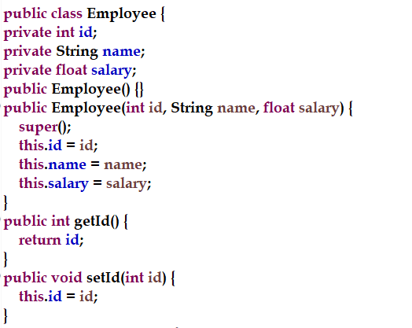
Spring jdbctemplate example

Slide 85
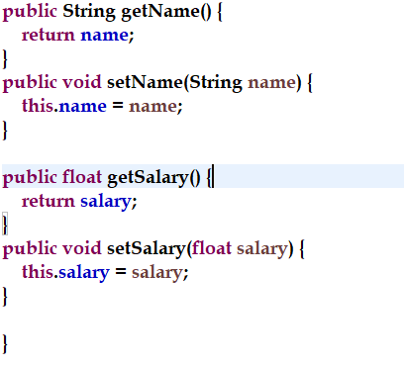
Spring jdbctemplate example

Slide 86
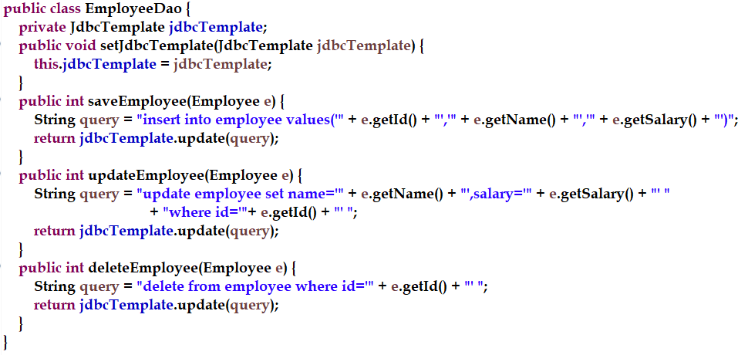
Spring jdbctemplate example

Slide 87
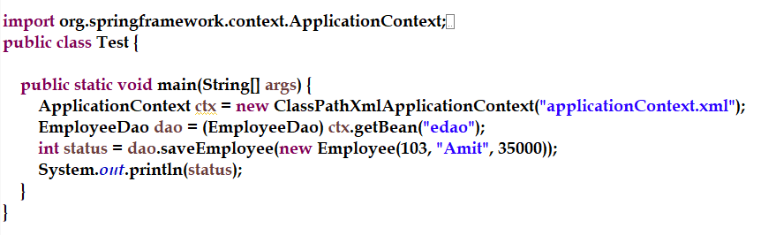
Spring jdbctemplate example

Slide 88

Spring jdbctemplate example

Slide 89

Spring jdbctemplate example

Slide 90
SPRING AOP
Aspect Oriented Programming (AOP) compliments OOPs in the sense that it also provides modularity. But the key unit of modularity is aspect than class.
AOP breaks the program logic into distinct parts (called concerns). It is used to increase modularity by cross-cutting concerns.
A cross-cutting concern is a concern that can affect the whole application and should be centralized in one location in code as possible, such as transaction management, authentication, logging, security etc.

Slide 91
SPRING AOP
AOP concepts and terminologies are as follows:
Join point
Advice
Pointcut
Introduction
Target Object
Aspect
Interceptor
AOP Proxy
Weaving

Slide 92
SPRING AOP
Aspect
This is a module which has a set of APIs providing cross-cutting requirements. For example, a logging module would be called AOP aspect for logging. An application can have any number of aspects depending on the requirement.
Join point
This represents a point in your application where you can plug-in the AOP aspect. You can also say, it is the actual place in the application where an action will be taken using Spring AOP framework.

Slide 93
SPRING AOP
Advice
This is the actual action to be taken either before or after the method execution. This is an actual piece of code that is invoked during the program execution by Spring AOP framework.
Pointcut
This is a set of one or more joint points where an advice should be executed.
Introduction
An introduction allows you to add new methods or attributes to the existing classes.

Slide 94
SPRING AOP
Target object
The object being advised by one or more aspects. This object will always be a proxied object, also referred to as the advised object.
Weaving
Weaving is the process of linking aspects with other application types or objects to create an advised object. This can be done at compile time, load time, or at runtime

Slide 95
TYPES OF ADVICE
Spring aspects can work with five kinds of advice mentioned as follows.
Before
Run advice before the a method execution.
After
Run advice after the method execution, regardless of its outcome.
after-returning
Run advice after the a method execution only if method completes successfully.
after-throwing
Run advice after the a method execution only if method exits by throwing an exception.
around
Run advice before and after the advised method is invoked

Slide 96
MVN integration Eclipse
Close the Eclipse
mvn eclipse:eclipse in project folder (pom.xml)

